Slide 1
RAILWAY
RESERVATION
SYSTEM
Review 2 · proposed project scope

Slide 2

PROJECT FRAME
Reservation quality shapes the whole journey
Make finding trains, checking seats, and completing a booking dependable.
A proposed system, not a report of local implementation or results.
02

Slide 3




LITERATURE MAP
The literature spans booking, architecture, and queues
Review three concerns: passenger transaction flow, platform reliability, and capacity under demand.
Railway reservation service
Passenger transaction flow
Capacity under demand
Booking steps overview
Platform reliability
Waiting, overbooking, channels
Concurrent access and security
Review rubric: depth · synthesis · evidence-based gap
03

Slide 4




PUBLISHED FINDING · SHAN ET AL. (2023)
E-ticketing research prioritizes scale and secure access
Database synchronization
High concurrency
Dynamic QR codes
Two-factor authentication
Support access as demand rises.
Strengthen ticket validation.
Keep ticket and seat state aligned.
Protect secure passenger access.
Design implication. Protect consistent seat and ticket state as demand rises.
04

Slide 5
PUBLISHED FINDING · QASIM AND FAROOQUIE (2024)
Queue research exposes the cost of capacity choices
CASE LENS
TRADE-OFF
Indian Railways
WAIT CAPACITY
VERSUS LOSS
Secondary queues, overbooking, and passenger flow reveal where capacity decisions become service costs.
Extra service channels may reduce waiting, while overbooking can create revenue loss and passenger friction.
05

Slide 6
SYNTHESIS
The studies solve different parts of one service
LENS | PRIMARY QUESTION | WHAT IT PROTECTS | PROJECT RELEVANCE
Architecture | Can the platform handle concurrent access? | Consistent transaction state | Reliable booking core
Security | Can access and tickets be trusted? | Passenger and ticket integrity | Secure access requirements
Queueing | How does demand affect waiting? | Capacity and service flow | Peak-demand handling
Synthesis | What must work together? | Integrity plus capacity | A dependable journey
06

Slide 7
PROJECT-SPECIFIC GAP
THE PROJECT CAN TEST THE INTEGRATION GAP
Architecture and security, queue economics, booking usability, and peak-demand handling are proposed as one evaluation scope.
This is a gap to validate in the project, not a claim that no prior work exists.
07

Slide 8
REVIEW 2 · PROVISIONAL AIM
Review 2 proposes a dependable booking workflow
01
02
Search trains
Check availability
Give passengers a clear starting point.
Expose current seat state.
03
04
Confirm booking
Look up status
Complete the reservation reliably.
Keep the journey traceable.
Scope to confirm. Project context, railway setting, and available evaluation data with the supervisor.
08

Slide 9
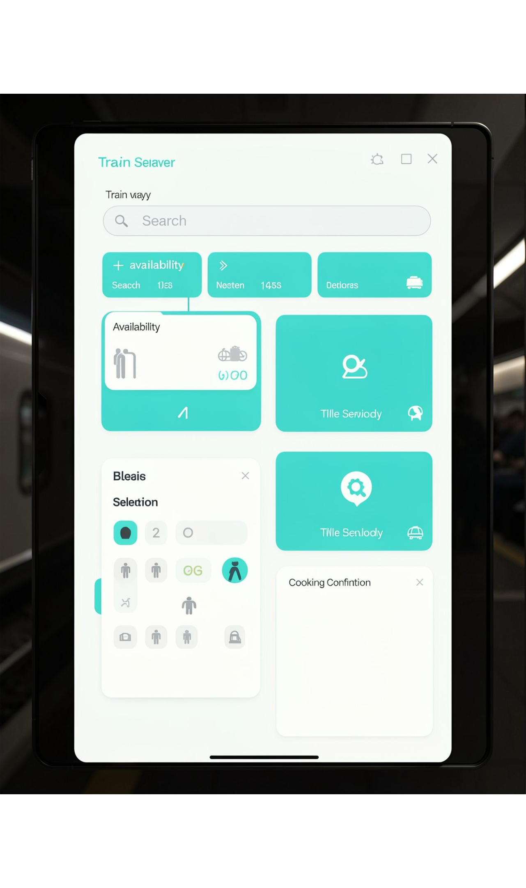

PROPOSED DESIGN · NOT COMPLETED FEATURES
Separate the passenger journey from core services
Passenger journey left-to-right through core services.
09

Slide 10



EVALUATION PLAN
Evaluate function, load, and usability separately
Function
Load
Usability
Search, seat availability, booking, and status updates.
Concurrent requests and consistent seat allocation.
Task completion and user feedback.
Reporting rule. Actual results are reported only after testing.
10

